Slide 1

Tutorial 5: Review for Midterm
COMP 249 CCCE
Object-Oriented Programming II

Slide 2
Tasks
Interfaces
Inner Classes
Enumarations
OOP
Classes
Access Modifiers
Data Hiding
UML Diagrams
Static & Final
Package

Slide 3
Interfaces
interface Test1{}
class MyClass implements Test1{}
Interface is not a class (can’t construct interface objects)
Can contain only method signatures and final fields
Can make a reference but cannot be instantiated
It is implemented (not extended) using implements keyword
When class implements interface, it becomes abstract (abstract keyword)
When you override all the methods, then class is concrete
Reference of interface can hold an object of a class
Test1 test = new MyClass();
Methods will be called based on object
Interfaces are to achieve runtime polymorphism, we need to override methods of interface

Slide 4
Interfaces
All methods are abstract by default
As methods are to be implemented by the classes, they can’t be made private
Method inside an interface cannot have body but the method can have body if the method is static
Static members can be accessed in main method by using interface name and dot operator
Interface can be extended from another interface
Class can implement multiple interfaces whereas it can only extends one class
Interface can extend other interfaces (supports multiple inheritance)
*Code Example: InterfaceExample

Slide 5
Inner Classes
Define class (inner class) inside another class (outer class)
Why?
To reduce complexity of a larger class
Inner classes can be hidden from other classes in same package
Methods of inner class can access data from the scope in which they are defined (f.e.private)
Types:
Nested Inner Classes – defined within the class, outside of methods of the outer class
Local Inner Classes – defined within block, have access to member of outer class. They are completely hidden from outside world
Anonymous Inner Classes – inner class without a name and for which only a single object is created
Static Inner Classes - static nested class is a static class defined within another class. They may be instantiated without instantiating the outer class

Slide 6
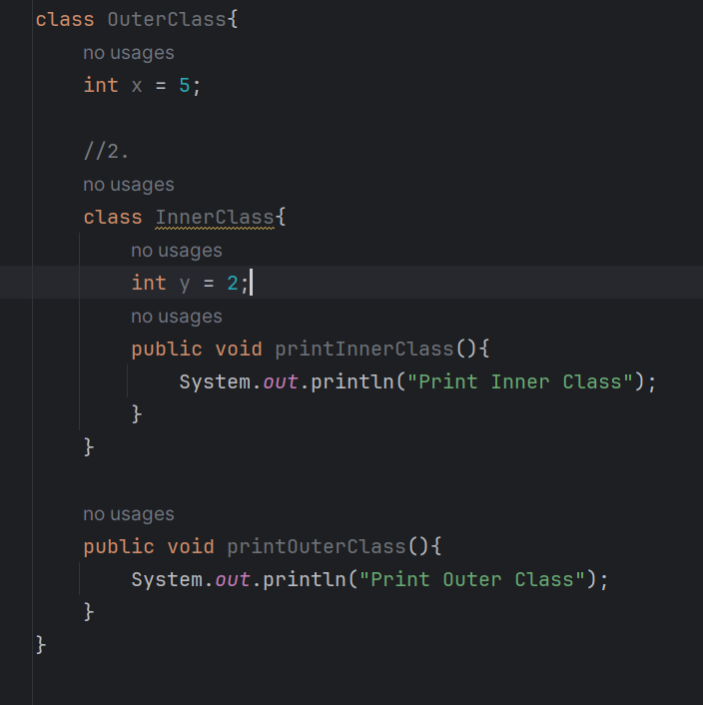
Inner Classes
Inner class can access members of the outer class directly
Outer class cannot directly use the members, only if it created an object
When compiling OuterClass.java (using javac command), we get OuterClass.class and OuterClass$InnerClass.class
Inner classes are genuinely more powerful than regular classes because they have more access privileges
You can access inner class from outside:
OuterClass.InnerClass oi = new OuterClass().new InnerClass();
*Code Example: InnerClassesExample

Slide 7
Enumarations
Enum is a special "class" that represents a group of constants (unchangeable variables, like final variables)
enum keyword allows you to create a new type with a restricted set of named values
enumerated type has a finite number of named values
Enums can also have fields, constructors, and methods.
The constructor of an enumeration is always private. You can omit the private modifier, as in the preceding example. It is a syntax error to declare an enum constructor as public or protected.
All enumerated types are subclasses of the abstract class Enum
*Code Exaple: EnumExample

Slide 8
OOP
Object-oriented program is made of objects. Each object has a specific functionality, exposed to its users, and a hidden implementation.
Traditional structured programming consists of designing a set of procedures(or algorithms) to solve a problem. Once the procedures are determined, the traditional next step was to find appropriate ways to store the data. First, they decided on the procedures for manipulating the data; then, they decided what structure to impose on the data to make the manipulations easier. OOP reverses the order: puts the data first, then looks at the algorithms to operate on the data.
Main principles of OOP:
Abstraction (avoid internal details & only things we require)
Encapsulation (Data hiding)
Encapsulation is the process of grouping data in a single section & hiding implementation details
Inheritance
Create a class by re-using the properties of the existing class
Polymorphism
Execute a single operation in different ways

Slide 9

Classes
Objects are constructed from Classes
Class is a design, blueprint that specifies how the objects are made
When you construct an object from a class, you are said to have created an instance of the class
Classes have properties (variables, data members) & behaviors (methods, functions)
Object is created : Phone p = new Phone();
One class can have many objects
If a class is a design, you can make many objects from the same design
Object is defined in terms of properties and behavior

Slide 10
Data Hiding
Usually data is hidden and operations are made visible; operations are performed over data
We hide the data by using private keyword
To access data we provide special property methods (getters and setters)
To give object “black box” behavior
Why?
To ensure internal state of object cannot be modified from outside
To control how the data is handled (f.e. set if statements) by using property methods
To ensure data security – use get and set methods to avoid misusing the data, or outside access to sensitive data

Slide 11
Access Modifiers
Default
Public
Private
Protected
Used to specify access level or visibility of the members of the class
Outer class can only default or public
Members | default | public | private | protected
Inside class | Accessible | Accessible | Accessible | Accessible
Child class inside package | Accessible | Accessible | Not accessible | Accessible
Parent class inside package | Accessible | Accessible | Not accessible | Accessible
Child class in different package | Not accessible | Accessible | Not accessible | Accessible
Parent class in different package | Not accessible | Accessible | Not accessible | Not accessible

Slide 12
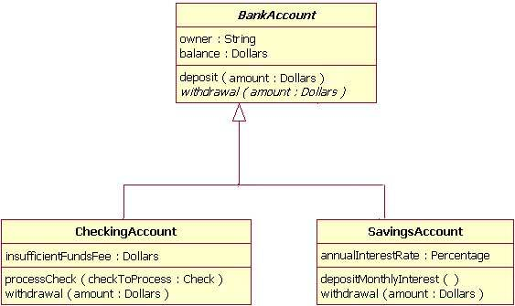
UML Class Diagram
UML notation
Class name written in bold ;
Abstract class name - in italic
Attributes & Methods (Operations) written in lowercase (camelCase):
+ Public
- Private
# Protected : accessible within its package
UML abstract class is a class without any instances
F.e. BankAccount class provides the abstract operation signature of withdrawal and the two child classes of CheckingAccount and SavingsAccount each implement their own version of that operation
https://developer.ibm.com/articles/the-class-diagram/#abstract-classes-and-operations8

Slide 13
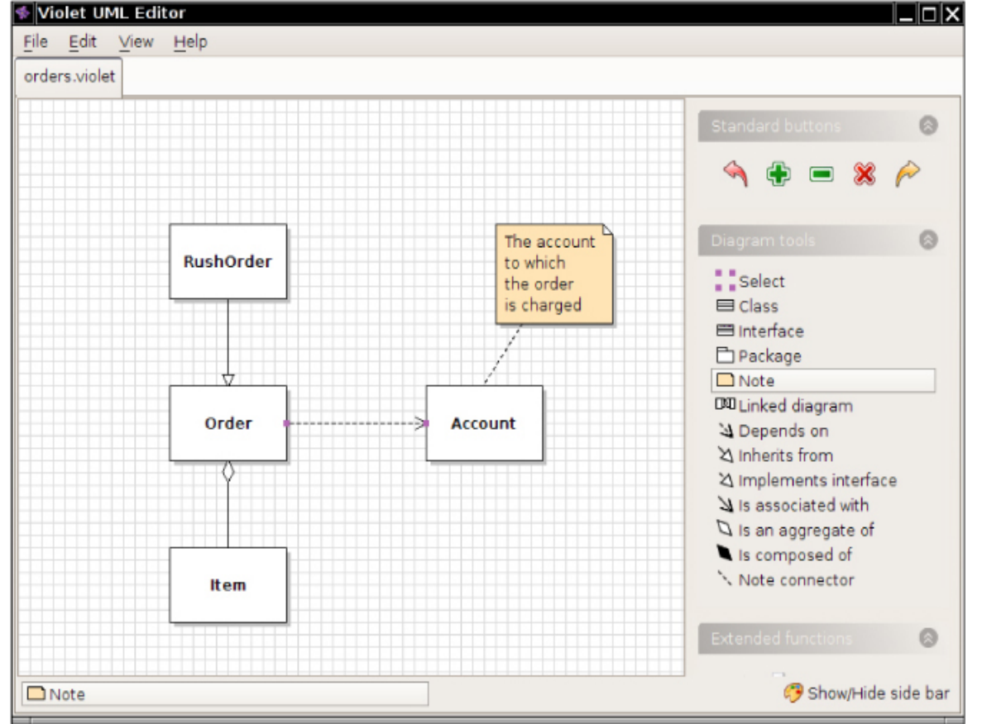
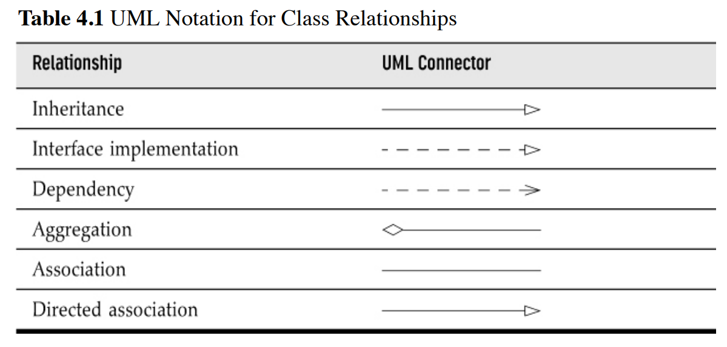
Relationships between Classes
Most common:
Dependence (“uses–a”)
Class depend on another class if its methods use objects of that class
Aggregation (“has–a”)
Objects of one class contain objects of another
Inheritance (“is–a”)
Subclass is specialized version of superclass
Horstmann, C. S. (2016). Core Java Volume I--Fundamentals. In Prentice Hall Press eBooks. http://dl.acm.org/citation.cfm?id=2898955

Slide 14














UML Class Diagram
Relationships between Classes:
Association – class knows about relationship with other class (f.e. student enroll in class)It is a static or physical connection between two or more objects.
Bidirectional Association - classes are aware of one another
Dependency - definition of class 2 depends on definition of class 1 (changes in class 1 effect class 2); weaker relatioship
Aggregation – class 2 is part of class 1 but the class 2 can be independent (Library and Book)
Composition – class 2 cannot exist without class 1 (composed of); it is subset of aggregation, dependency: one part is deleted, the other one as well
Inheritance – class 2 and 3 are subclasses (children) of parent class, they extend the parent
Realization(Inheritance Implementation) – class 1 is blueprint for class 2 and 3; indicates that a class implements the features of an interface

Slide 15
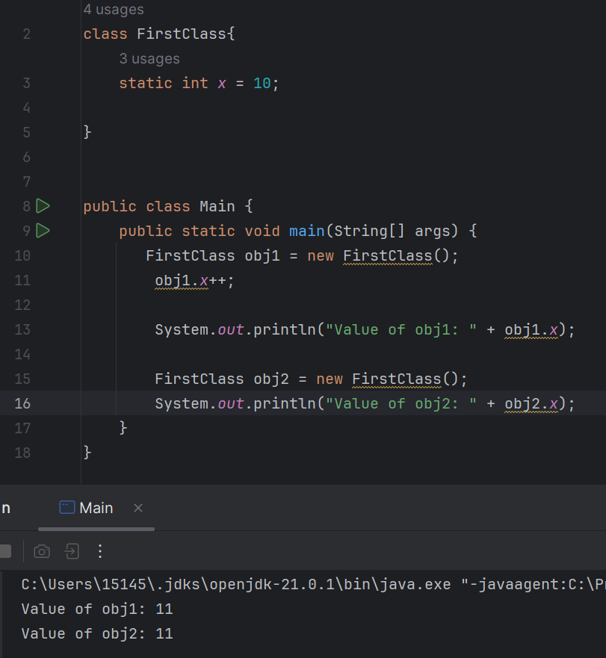

Static & Final
Static variables are shared between all instances of class
You can even access x by using :
System.out.println(FirstClass.x);
Final variables can only be assigned once, the value cannot be changed after that (constants

Slide 16
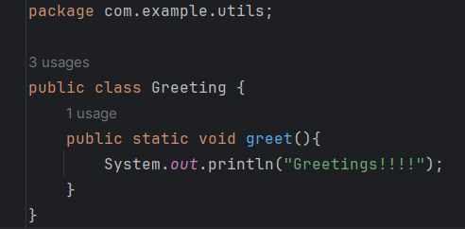
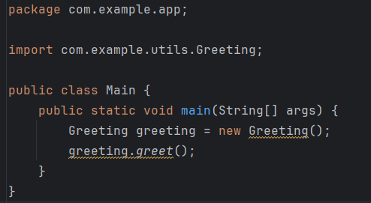
Package
src/com/example/
app/
Main.class
utils/
Greeting.class
It is collections of classes, interfaces
Used to organize java projects under a single namespace
It is basically a folder or directory
If you use a package statement, it must appear as the first non-comment in the file (this compilation unit is part of a library named package_name): package package_name
By putting package statement at the top, you are making the public class withing this compilation unit
Then if you want to use class from another package, you have to import it by putting at the top (after package statement if it is the case)
A package is a convenient way of grouping together many different classes that have a common purpose
We can also import standard java libraries
Members of classes in a given package that have the protected qualifier are available anywhere within the same package, and also from any subclass of a class in the given package that appears in another package.

Slide 17
Package
src/com/example/
app/
Main.class
utils/
Greeting.class
Package access allows you to group related classes together in a package so that they can easily interact with each other.
When you put classes together in a package, thus granting mutual access to their package-access members, you “own” the code in that package.

Slide 18
References
Core Java Volume I: Fundamentals 12th edition by Cay S.Horstmann
Thinking in Java 4th edition by Bruce Eckel
https://www.w3schools.com/java/java_enums.asp
https://www.javatpoint.com/java-inner-class
https://www.javatpoint.com/uml-class-diagram
https://cs.smu.ca/~porter/csc/465/notes/javapl_packages.html

